Slide 1
INTRODUCTION TO PHISHING ATTACKS
Understanding Phishing Attacks:
Phishing is a type of cyber attack where attackers impersonate legitimate entities to steal sensitive information. This is why it is important to enlighten people what this attack means and how the attack works due tomit increasing frequency and sophiscation.

Slide 2
WHAT IS PHISHING
Phishing is a fraudulent attempt to obtain sensitive information by disguising as a trustworthy entity.
Common targets: Login credentials, credit card numbers, personal identification information.

Slide 3
COMMON TYPES OF PHISHING
Email Phishing: Fake emails from seemingly legitimate sources.
Spear Phishing: Targeted attacks on specific individuals or organizations.
Whaling: Targeting high-profile individuals like executives.
Smishing: Phishing through SMS/text messages.
Vishing: Phishing through voice calls.

Slide 4
RECOGNIZING PHISHING EMAILS
Suspicious Sender: Check the email address.
Generic Greetings: "Dear Customer" instead of your name.
Urgent Language: Claims of urgent action required.
Spelling and Grammar Errors: Poor language quality.
Unusual Attachments or Links: Hover over links to check URLs.

Slide 5
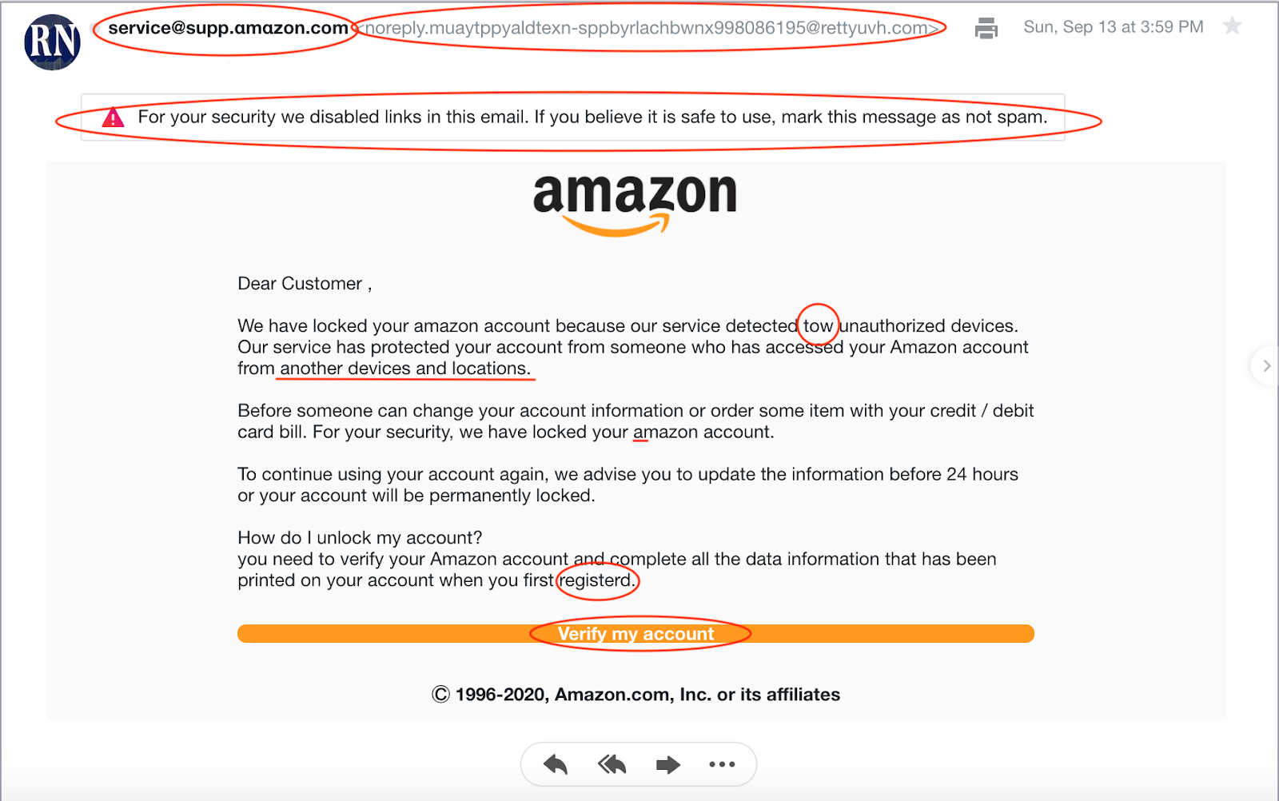
EXAMPLE OF PHISHING EMAIL
What to note here:
Wrong address
The email already flagged it as a possible scam
Extra Character and words
Grammatical and spelling error

Slide 6
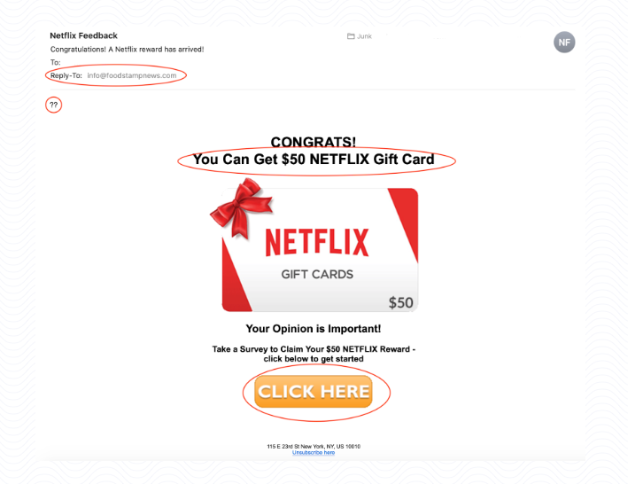
EXAMPLE OF PHISHING EMAIL
What to note here
Wrong address to reply to info@foodstampnews.com
Grammatical and spelling error, also unnecessary capitalization
Shorten words like “CONGRATS!”
Suspicious link ASSOCIATED WITH SCAMMERS “CLICK HERE”

Slide 7
RECOGNIZING PHISHING WEBSITES
Check the URL: Look for slight misspellings or extra characters.
HTTPS and SSL Certificates: Ensure the site is secure (look for the padlock symbol).
Website Design: Poor design or outdated visuals.
Suspicious Pop-ups: Requests for sensitive information.

Slide 8
SOCIAL ENGINEERING TACTICS
Pretexting: Creating a fabricated scenario to steal information.
Baiting: Offering something enticing to get the victim to provide information.
Quid Pro Quo: Offering a service or benefit in exchange for information.
Tailgating: Physically following someone to gain access to restricted areas.

Slide 9
HOW TO PROTECT YOURSELF
Verify Requests: Confirm requests for sensitive information through a separate communication channel.
Use Security Software: Install and update antivirus and anti-malware programs.
Educate Yourself: Stay informed about the latest phishing techniques.
Enable Two-Factor Authentication (2FA): Adds an extra layer of security.
Report Suspicious Emails: Notify your IT department or use the report feature in your email client.

Slide 10
WHAT TO DO IF YOU FALL VICTIM
Report Immediately: Inform your IT department or the relevant authority.
Change Passwords: Update passwords for compromised accounts.
Monitor Accounts: Check bank and credit card statements for unauthorized transactions.
Run a Security Scan: Use antivirus software to check for malware.

Slide 11
CONCLUSION AND SUMMARY
What was talked about in the presentation:
The definition of Phishing
Common types of phishing
Recognizing phishing emails
Examples of phishing emails
Recognizing phishing websites
Social engineering tactics
Countermeasures and how to protect yourself
What to do if fall victim

Slide 12
QUESTION AND ANSWER

